Slide 1

Topics of today
1. NETWORK INTERFACE CARD
2. Transmission Media and topologies media
3. Crimping tools and Color standards for Straight crimping and Cross crimping

Slide 2
NETWORK INTERFACE CARD
A network interface card (NIC) is a hardware component without which a computer cannot be connected over a network. It is a circuit board installed in a computer that provides a dedicated network connection to the computer. It is also called network interface controller, network adapter or LAN adapter.

Slide 3

PURPOSE OF NIC
NIC allows both wired and wireless communications.
NIC allows communications between computers connected via local area network (LAN) as well as communications over large-scale network through Internet Protocol (IP).
NIC is both a physical layer and a data link layer device, i.e. it provides the necessary hardware circuitry so that the physical layer processes and some data link layer processes can run on it.

Slide 4
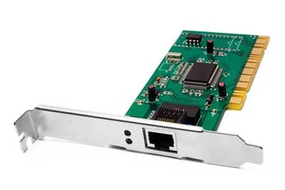

TWO TYPES OF NIC 1. INTERNAL NETWORK CARDS
In internal networks cards, motherboard has a slot for the network card where it can be inserted. It requires network cables to provide network access. Internal network cards are of two types. The first type uses Peripheral Component Interconnect (PCI) connection, while the second type uses Industry Standard Architecture (ISA).

Slide 5
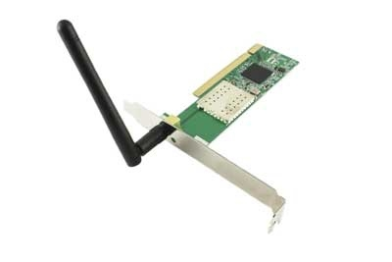

2. EXTERNAL NETWORK CARDS
In desktops and laptops that do not have an internal NIC, external NICs are used. External network cards are of two types: Wireless and USB based. Wireless network card needs to be inserted into the motherboard, however no network cable is required to connect to the network. They are useful while traveling or accessing a wireless signal.

Slide 6

Transmission Media
A communication channel that is used to carry the data from the transmitter to the receiver through the electromagnetic signals.
The main function of this is to carry the data in the bits form through the Local Area Network (LAN). In data communication, it works like a physical path between the sender & the receiver.

Slide 7
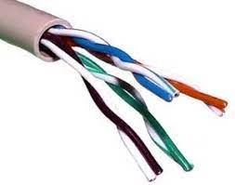
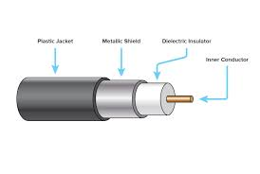
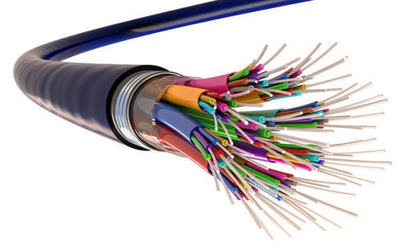

TYPES OF TRASMISSION MEDIA
1. First one is guided media which is also know as physical transmission media. (physical path needed to transmit a signal)
2. There are types of guided media which are
Twisted pairs
Coaxial cables
Fibre optic
1. Second one is unguided media which is a also known as wireless transmission media.(air path needed to transmit a signal)
2. There are so many wireless media which are
Radio
Cell phone
Microwave

Slide 8

TOPOLOGIES MEDIA
A network topology is the physical and logical arrangement of nodes and connections in a network. Nodes usually include devices such as switches, routers and software with switch and router features. Network topologies are often represented as a graph. Network geometry can be defined as the physical topology and the logical topology.

Slide 9
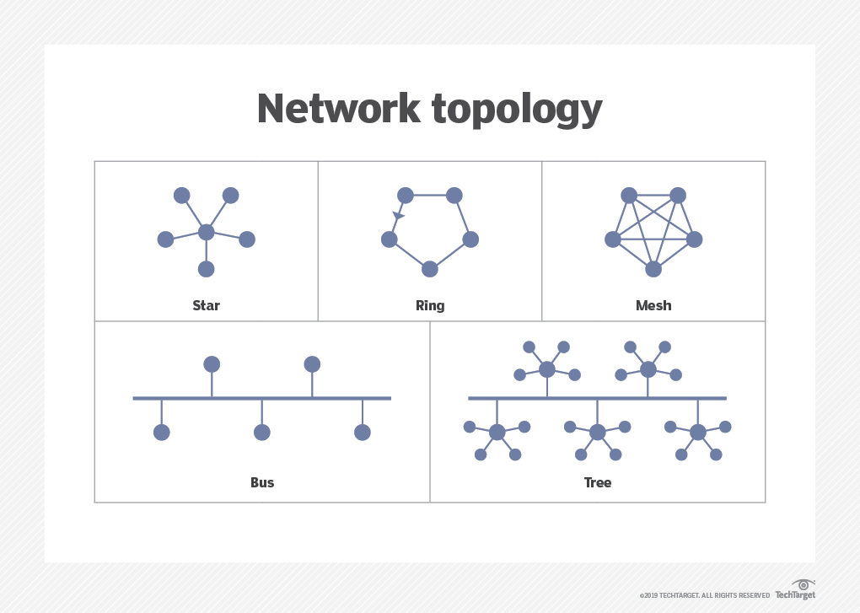

TYPES OF TOPOLOGIE

Slide 10
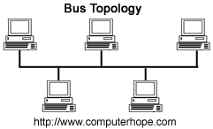
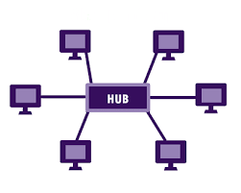
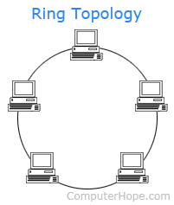

TYPES OF TOPOLOGIES
Bus network. In the bus network topology, every node is connected in series along a single cable. This arrangement is found today primarily in cable broadband distribution networks.(broadcast mgs), take time , cable length limited, less expensive, one system is failed so this is not affected to other devices.
Star network. In the star network topology, a central device connects to all other nodes through a central hub. Switched local area networks based on Ethernet switches and most wired home and office networks have a physical star topology.(connected all device to hub, broadcast data, less expensive, easily add another device, we needed a hub,switch,if hub is failed so entire network is failed
Ring network. In the ring network topology, the nodes are connected in a closed-loop configuration. Some rings pass data in one direction only, while others are capable of transmission in both directions. (forms a ring, connect to a side nodes strongly, strong network forms data sent clock wise and antilock wise, broadcast network)

Slide 11
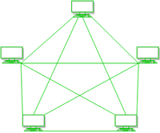
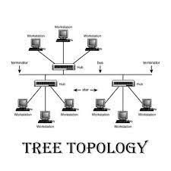

TYPES OF TOPOLOGIES
Mesh network. The mesh network topology links nodes with connections so that multiple paths between at least some points of the network are available. A network is considered to be fully meshed if all nodes are directly connected to all other nodes and partially meshed if only some nodes have multiple connections to others.
Tree network. The tree network topology consists of one root node, and all other nodes are connected in a hierarchy. The topology itself is connected in a star configuration. Many larger Ethernet switch networks, including data center networks, are configured as tree(bus and star)

Slide 12
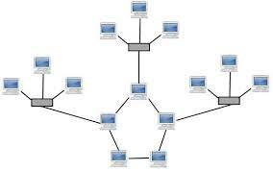
TYPES OF TOPOLOGIES
Hybrid network. The hybrid network topology is any combination of two or more topologies. Hybrid topologies typically provide exceptional flexibility, as they can accommodate a number of setups. For example, different departments in the same organization may opt for personalized network topologies that are more adaptable to their network needs.

Slide 13

Crimping tools and Color standards for Straight crimping and Cross crimping
A crimping tool is a device used to conjoin two pieces of metal by deforming one or both of them in a way that causes them to hold each other. The result of the tool's work is called a crimp.
For instance, network cables and phone cables are created using a crimping tool (shown below) to join the RJ-45 and RJ11 connectors to both ends of either phone or Cat 5 cable.

Slide 14
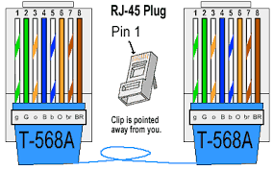
ETHERNET CABLE CORD
A straight-thru is used as a patch cord in Ethernet connections.
A crossover is used to connect two Ethernet devices without a hub or for connecting two hubs.
A crossover has one end with the Orange set of wires switched with the Greenest.

Slide 15
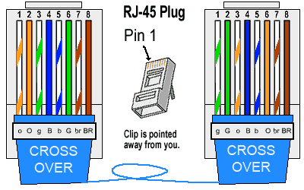
RJ -45 Crossover Ethernet Cable
A good way of remembering how to wire a Crossover Ethernet cable is to wire one end using the T-568A standard and the other end using the T-568B standard.
Another way of remembering the color coding is to simply switch the Green set of wires in place with the Orange set of wires. ● Specifically, switch the solid Green (G) with the solid Orange, and switch the green/white with the orange/white.

Slide 16
Ethernet Cable Instructions
Pull the cable off the reel to the desired length and cut. If you are pulling cables through holes, its easier to attach the RJ-45 plugs after the cable is pulled.
The total length of wire segments between a PC and a hub or between two PC's cannot exceed 100 Meters (328 feet) for 100BASE-TX and 300 Meters for 10BASE-T
Start on one end and strip the cable jacket off (about 1″) using a stripper or a knife. Be extra careful not to nick the wires, otherwise you will need to start over.

Slide 17
Ethernet Cable Instructions
Spread, untwist the pairs, and arrange the wires in the order of the desired cable end. Flatten the end between your thumb and forefinger. Trim the ends of the wires so they are even with one another, leaving only 1/2″ in wire length.
If it is longer than 1/2″ it will be out-of spec and susceptible to crosstalk. Flatten and insure there are no spaces between wires.
Hold the RJ-45 plug with the clip facing down or away from you. Push the wires firmly into the plug.

Slide 18
Ethernet Cable Instructions
Inspect each wire is flat even at the front of the plug. Check the order of the wires. Double check again. Check that the jacket is fitted right against the stop of the plug. Carefully hold the wire and firmly crimp the RJ-45 with the crimper.
Check the color orientation, check that the crimped connection is not about to come apart, and check to see if the wires are flat against the front of the plug. If even one of these are incorrect, you will have to start over. Test the Ethernetcable.

Slide 19
THANK YOU

